Slide 1
Stratified care for Low Back Pain – implementing STarT Back into clinical practice
Helen Duffy¹, Kay Stevenson²
Primary Care Research Consortium Manager
Consultant Physiotherapist/NIHR Knowledge Mobilisation Fellow

Slide 2
The STarT Back Story
Back pain is common
85% will have non specific low back pain
Factors such as fears, anxiety, mood motivation and work situation should be assessed (van Tulder et al, 2006)
Large randomised trial that demonstrated that the use of a screening tool and matched treatment was clinically and cost effective for patients with back pain (Hill et al, 2011)

Slide 3
STarT Back RCT
Screening
Matched pathways
+

Slide 4
STarT Back screening tool
Brief prognostic tool
Takes 2 minutes to complete
Designed to help clinicians produce an index of modifiable risk factors
Used to stratify patients to matched treatments
Tested for validity and reliability in different populations

Slide 5
STarT Back screening tool
Thinking about the last 2 weeks tick your response to the following questions
 |  | Disagree | Agree
 |  | 0 | 1
1 | My back pain has spread down my leg (s) at some time in the last 2 weeks | □ | □
2 | I have had pain in the shoulder or neck at some time in the last 2 weeks | □ | □
3 | I have only walked short distances because of my back pain | □ | □
4 | In the last 2 weeks, I have dressed more slowly than usual because of back pain | □ | □
5 | It’s not really safe for a person with a condition like mine to be physically active | □ | □
6 | Worrying thoughts have been going through my mind a lot of the time | □ | □
7 | I feel that my back pain is terrible and it’s never going to get any better | □ | □
8 | In general I have not enjoyed all the things I used to enjoy | □ | □
9. Overall, how bothersome has your back pain been in the last 2 weeks
Not at all | Slightly | Moderately | Very much | Extremely
□ | □ | □ | □ | □
0 | 0 | 0 | 1 | 1

Slide 6
Stratified Care Model
High
Psychologically informed physiotherapy
Medium risk
Course of physiotherapy
Low risk
Minimal treatment – advice, reassurance and pain relief
Complexity
Notes:
We defined low risk patients as patients who were not cases based on the prognostic factors And we chose the cut-off for low risk based on the screening tool overall score that most consistently discriminated between reference standard cases and non-cases (ie, with the highest average sensitivity and specificity)
To choose the cut-off for medium and high risk patients, we used ROC curves of the screening tool psychosocial subscale scores against those items full reference standards and wanted to spot patients who were consistent in having these predictive factors.
Particular consideration was given to a cutoff with high specificity so make it a high cut-off to get into the high risk group (ruling out patients who did not have consistent psychosocial predictors from the high risk group) – as physiotherapy has been shown to be effective for patients with moderate levels of psychosocial distress.
The tool produced 40% patients low risk, 35% patients medium risk and 25% high risk in development sample And 47% low risk, 38% medium risk, 15% high risk in the validation sample
In terms of discrimination: at follow-up: 16% of low risk patients had a poor outcome, 53% in medium risk group had a poor outcome, 78% of the high risk group had a poor outcome

Slide 7
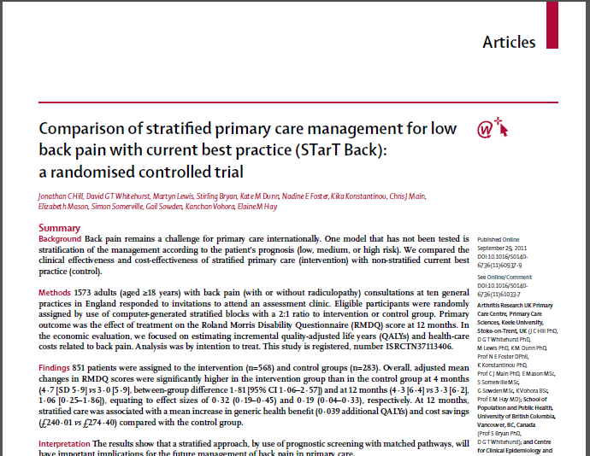
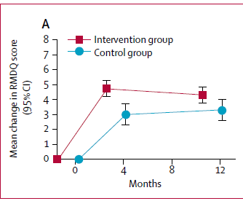
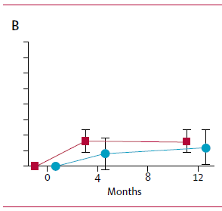
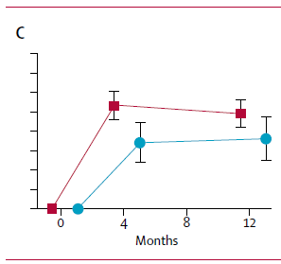
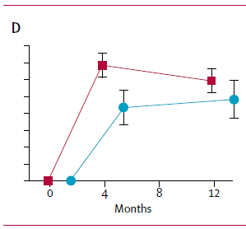
Hill et al, 2011 (n=851)
Improved clinical outcomes
Improved patient satisfaction
Much less time off work
4. Stratified care was cheaper, saving:
an average £34 per individual (health costs)
An average £675 per individual (societal costs)
Proof of principle RCT

Slide 8
Key results
Change in physiotherapy referral patterns
Low risk referral:
49% controls
7% targeted group
Medium risk patients:
60% controls
98% targeted group
High risk patients:
65% controls
100% targeted
Cost Savings
GP consultations
Visits to NHS consultants
Investigations
MRI & x-rays
Epidural injections
Other private healthcare
Medication
Significant reduction in time off work
Fewer referrals
More referrals early
More referrals early
Whitehurst et al 2012 Ann Rheum Dis
Notes:
Clearly savings were achieved across the 2 studies – what Impact Back showed us was that these savings could still be achieved when the approach was adopting in a ‘real’ life scenario.
Service managers/commissioners will recognise that the savings cited above hit many of the targets that the NHS have been trying to achieve over the last 5 years – both across primary and secondary care (including medicine management targets).

Slide 9
Key messages
High quality randomised controlled trial has demonstrated that using the STarT Back screening tool plus matched treatments – tested in an implementation study (IMPaCT Back)
Improves patient clinical outcomes
Improves referral to physiotherapy
Reduces healthcare and societal costs – in research & implementation studies

Slide 10
But can these approaches be implemented in day-to-day practice?

Slide 11
Implementing STarT Back in day to day practice
Local adoption (North Staffs pilot with SSOTP)
Regional Cluster Pilots across West Midlands AHSN

Slide 12
Problems identified locally
Patients expect active investigation/treatment
GPs may be uncertain about:
Best management
Services available
Physiotherapy access and waiting times
Lack of feedback from Physio

Slide 13
Staffordshire and Stoke on Trent NHS Partnership Trust – pilot implementation
Locality GP cluster (Biddulph/Leek)- covers rural and market town population
615 referrals of low back pain in 12 months
Patients referred through GP contact and Physio direct triage service
GP & Physiotherapy clinical leads – reviewed pathway, need to improve discharge communication
RESULTS – Oct 2013
Avoided over treating patients
New to follow up ratios: Low Risk (24%) 1:1.3 Medium Risk (35%) 1:3 High Risk (41%) 1:4
Reduced waiting times
Pre pilot = 52%; During pilot - 80% seen within target wait time
Achieved 100% patient satisfaction
Improved discharge letters back to GP (90% vs 26%)
Reduced the number of patients being referred on for second opinion (1% to Impact service)
Ensured patients receive appropriate treatment, delivered by highly trained physiotherapists

Slide 14
Stafford & Surrounds CCG
Membership Board – 5th March 2014
Innovation Group – 3rd April 2014
Agreed to implement in practice
Physiotherapy – baseline audit, training in place for teams

Slide 15
Telford & Wrekin CCG
Newport/Shifnall Community MSK
Reduced follow up/not over treating

Slide 16
Next steps:
Collaborative project led by Keele University within the Integrated Care/Long Term Conditions Theme, West Midlands Academic Health Science Network
Supporting uptake in general practice:
- innovation = the development of a computer platform to generate referrals to
physiotherapy utilising evidence based tool – EMIS/SystmOne
STarT Back tool ‘fires’ with appropriate read code and once completed offers:
Low risk = high quality patient information – patient.co.uk;
Medium/High Risk = pre populated referral form to physiotherapy for automated submission to physio services
- quality indicator = using a screening tool and matched treatments, for
patient with low back pain, improves clinical outcomes and reduces cost
- provision of high quality patient information (PPI group/patient.co.uk)
Supporting clinical pathway development
- training in physiotherapy treatments (43 trained within WM AHSN)
- facilitation events
- audit tools

Slide 17
GP Consultation
Referral to Physiotherapy generated automatically
Appropriate Physiotherapy treatment
Good quality patient information
(patient.co.uk)
System developed with GPs
Training for physios provided

Slide 18
What we aim to achieve
Assist GP referral by using:
Integrated referral template within EMIS/SystmOne–Better use of physiotherapy services:
Early targeted referral
Shorter waiting times
Improved feedback to GP on outcome
Improved patient information
Fewer repeat consultations for GPs

Slide 19
Integrated Care Theme – West Midlands Academic Health Science Network
Pilot clusters across WM AHSN – stratified care for low back pain
Project Management Support
Identify GP locality & referring sites
Install screening tool – offer GP training
Competency/Training for Physiotherapy – matched treatment options
Working with EMIS & System One to embed tool
High quality patient information – user group, patient.co.uk
Promotional DVDs
Website
Pilot with North Staffs CCG – integrated IT platform

Slide 20
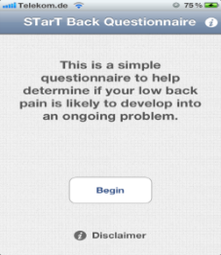
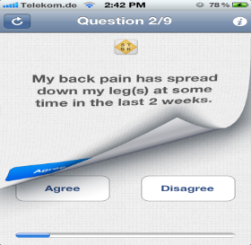
National Tools
Department of Health
AHP QiPP Guidelines
Any Qualified Provider documentation
MSK commissioning online toolkit
App /AXA DVD
Pain Management Guidelines
Map of Medicine (RCGP/British Pain Society)
Tool added into National Spine Registry British Association of Spinal Surgeons
Arthritis Research UK/BMJ e-learning modules; GP Update Course (NB Medical)
STarT Back website
www.keele.ac.uk/sbst/‎

Slide 21
Acknowledgements
The STarT Back & IMPaCT Back study teams
GP practices and physiotherapy services
Study participants
Full information on website www.keele.ac.uk/startback
With 20 min DVDs explaining the approach

