Slide 1
What type of information do service providers/ commissioners need? – good quality evidence to underpin service delivery/commissioning
Quality
Preventing harm
Enhanced experience / satisfaction
Innovation
Care closer to home
Productivity
Speedier access
Prevention
Timely access
Independence
Early intervention
Maximise independence
Prevent reliance on health care
Quality of life
Dealing with increasing demand
Best practice
Screening
Matched pathways

Slide 2
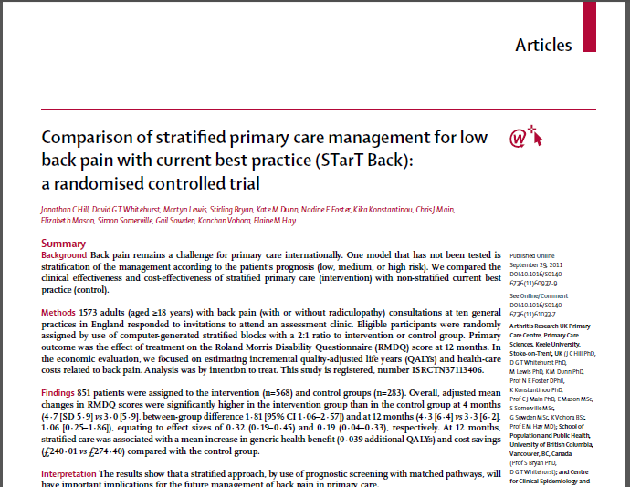
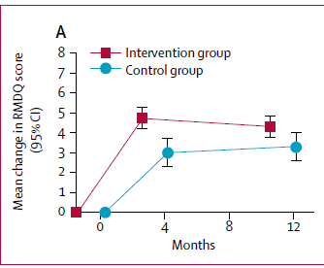
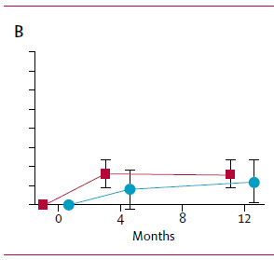
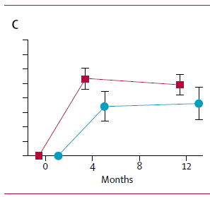
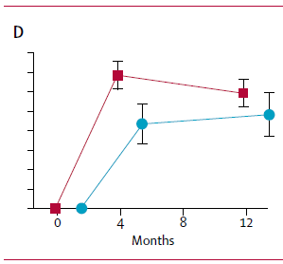
STarT Back RCT (n=851) (Hill et al, 2011)
Slides that have proved most useful to me!
Improved clinical outcomes
Improved patient satisfaction
Much less time off work
4. Stratified care was cheaper
Average £34 per individual (health costs)
Average £675 per individual (societal costs)
Proof of principle RCT

Slide 3
Key cost savings
STarT Back trial
GP consultations
Visits to NHS consultants
Investigations
MRI/x-rays
Epidural injections
Other private healthcare
Medication
IMPaCT Back study
GP consultations
Visits to NHS consultants
Visits to private consultants
Other private healthcare
Medication
Whitehurst et al 2012 Arthritis and Rheumatic Diseases
Notes:
Clearly savings were achieved across the 2 studies – what Impact Back showed us was that these savings could still be achieved when the approach was adopting in a ‘real’ life scenario.
Service managers/commissioners will recognise that the savings cited above hit many of the targets that the NHS have been trying to achieve over the last 5 years – both across primary and secondary care (including medicine management targets).

Slide 4
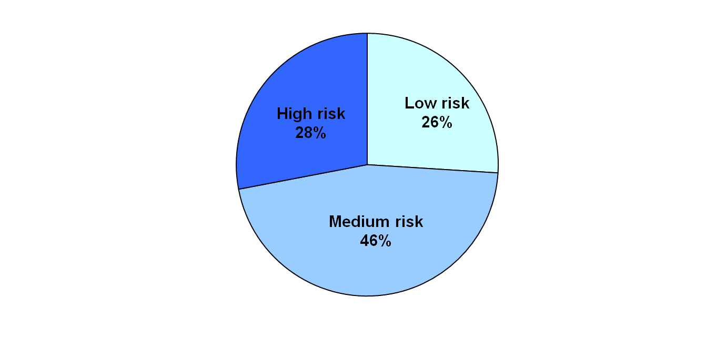
Change in referral patterns
Low risk referral:
49% controls
7% targeted group
Medium risk patients:
60% controls
98% targeted group
High risk patients:
65% controls
100% targeted
Overall referral: Control = 58%
Targeted = 75%
Effect on Physio referrals:
Much less referral,
More referrals early
More referrals early

Slide 5
For evidence translation our results need to fit into national context
CRES, CIP, Invest 2 Save, QiPP, QP
All have needed to demonstrate:
Cost effectiveness = for the service implementing it (service provider) or across pathway (commissioner)
Value for money – could be pump primed (e.g. I2S)
Reduce variation
Savings – within x years
Savings set out as “costed pathways” (current v proposed) using PbR tariffs

Slide 6
Current climate
Need within year savings (e.g. if investment needed for training then saving needs to be demonstrated within year)
Cost savings of new approach by Y3
Impact on staffing levels – opportunity costs – ie patient returning for fup less often – does this release staff time? (in the case of STarT Back – is this true for GP/Physiotherapy?
Impact in terms of reducing primary care & secondary care costs through implementation
e.g the incidence of back pain is: XX per 1000 in your population then the costs averted through implementation are:
- x epidurals per 1000 head of population
- x surgical procedures averted (using HRG)
- x outpatient attendances saved (new/follow up tariff)

Slide 7
Can we represent our findings in the language of the NHS?
using national initiatives to inform needs
using HRGs/PbR/reference costs/national benchmarking data

Slide 8
Example of Audit Data requirements from two NHS organisations:
Referrals from GP clinics
Use of StarT Back tool by GP
Use of StarTBack tool by physiotherapy service
Matched treatments (stratified care)
Number of treatments
Outcomes
DNA rate
Referral to interface
Support from clinical specialist
Physiotherapy Staff survey
GP survey
Patient stories
Would you recommend to a friend?
Referrals to neurosurgery via specialist spinal team
Referrals to orthopaedics via specialist spinal team
Referral type – Emergency / Urgent / Routine / 2 week cancer wait
Pain type - neck, thoracic, lumbar, mixed, not specified
Nerve root pain (eg referred pain to arm or leg, or ‘sciatica’, or ‘radiculopathy’) present or not
Detail of timescale of symptoms – under 6 weeks, 6 weeks to 3 months, longer than 3 months, not recorded
Surgical input required. If yes, details
Detail of a psychosocial assessment (including use of STarT back tool), or not recorded.

Slide 9
Example - Template
Strategy | 12/13 scheme or new | Scheme | Prog Lead | Clinical Lead | Proposed Start Date of Scheme | Proposed Start date of savings impact | Activity currency | Total Activity Change 13-14 | FYE of activity change | Total Financial impact 13-14 £'000 | FYE of Financial impact £'000 | Comments
Planned Care | New
 | New
 | New
 | New | Introduction of Back Pain Pathway, including direct access to MRI for lumbar spines, leading to reduction in referrals to Secondary Care | NW | JP |  |  | O/P first & F/U.Electives |  |  |  |  | xx% redn at

